Slide 1
Community Needs
an overview of support & resources
Teri Allen McDonough, LSW
teri@marbleheadcounseling.org

Slide 2
MHA
&
MCC
Marblehead Housing Authority Marblehead Counseling Center
Resident Service Coordinator Social Service Coordinator
306 units total Through a collaboration with
222 elderly/disabled the Board of Health, MCC
84 family provides financial assistance,
resource & referrals including
Clients: housing counseling, public
current MHA tenants benefit advocacy & more to
any town resident of any age.

Slide 3
Local Partners
Town of Marblehead
Health Department
Marblehead Police & Fire
Marblehead Public Schools
COA
Veterans Agent
Marblehead Female Humane Society
Making Ends Meet
Marblehead Food Pantry
MMA (Marblehead Ministerial Assoc.)
Rotary
Elderact
Anchor to Windward
YMCA
JCC
SPUR

Slide 4
Regional Partners
NSCAP (North Shore Community Action)/Fuel assistance
ESMV/Danvers (Elder Services)
DCF (Dept. of Children & Families)
NSPG (No Shore Physicians Group)
Northeast Legal Aid/ Northeast Justice Center
LHAND/ Family Success Center
Northeast ARC
DTA (Dept of Transitional Assistance)
DRC (Disability Resource Center)
HAWC (Healing Abuse, Working for Change)
Salvation Army
Catholic Charities
JFCS (Jewish Family & Children’s Svcs)
MassHire/ North Shore Career Center

Slide 5
Referrals
MHA: (781) 631-2580 tamcdonough@marbleheadha.org
Tenants, MHA staff, family members, concerned neighbors, doctor’s office & others
MCC: (781) 631-8273
teri@marbleheadcounseling.org
Town residents, clinicians, family & friends, utility providers & others

Slide 6
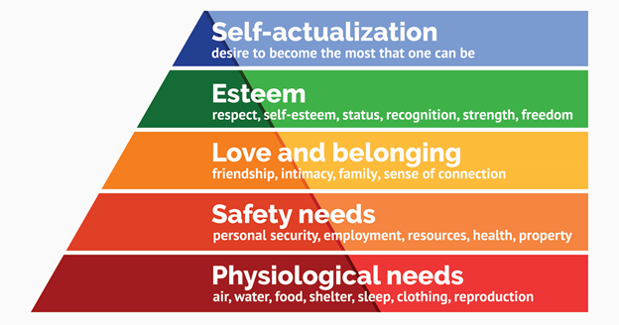
Intake
&
Assessment

Slide 7
Services
Financial assistance
Food
Housing
Elder services
Family & Children’s Services
Transportation
Health insurance
Advocacy

Slide 8
Financial assistance
Emergency assistance
Application for one-time aid
Advocacy & payment plan negotiation
Financial coaching

Slide 9
Food
Emergency assistance
Holiday meals & vouchers
Referrals to:
SNAP (DTA), Food Pantry, Farmers to Families, enhanced Farmer’s Market benefits (HIP)
COA: grab & go lunches, CSFP, Farmer’s Market

Slide 10
Housing
CHAMP (Common Housing Application for Massachusetts Housing Programs) application - state aided housing and AHVP (Alternative Housing voucher Program)
MassHousing search
Rooming houses & homeshares
Homeless shelters

Slide 11
Elder Services
COA
ESMV/Danvers homecare
Private homecare & other services
Memory care
Care coordination
Caregiver support
Protective Services

Slide 12
Family & Children’s Services
Special Education services (IEP)
CRA (Child Requiring Assistance)
Camperships
Holiday giving programs
counseling

Slide 13
Transportation
Public transportation (travel training)
COA van
The Ride
Companion care rides
vouchers

Slide 14
Health insurance
SHINE (Serving Health Information Needs of Elders)
Yearly checkup
Patient Financial Services
Reinstatement of benefits

Slide 15
Advocacy:
connecting the dots
Fuel assistance
Homecare
Legal services
DTA (Department of Transitional Assistance)
Social Security
Unemployment
Special Education
Resources for folks with disabilities

Slide 16
Building Capacity:
addressing unmet needs in our community

